Slide 1
Predicting Loan Defaults Using Machine Learning
Capstone 2 by Dardeep Somel

Slide 2
Introduction
Content:
Overview of Lending Club
Project Objective: Develop a model to predict loan defaults with at least 85% accuracy
Importance: Helps Lending Club manage risk and make informed lending decisions

Slide 3
Dataset
Source: Lending Club Loan Data from Kaggle
Key Features:
Borrower personal information
Loan data
Credit utilization
Additional information like loan purpose

Slide 4
Data Preparation
Data Cleaning: Handling missing values, outliers, and infinite values
Feature Engineering: Creating new features to improve model performance

Slide 5
Modeling Approach
Model Selection: Random Forest and Gradient Boosting
Hyperparameter Tuning: Using RandomizedSearchCV
Addressing Class Imbalance: SMOTE and class weight adjustments (Potential Future approaches)

Slide 6
Model Evaluation
Performance Metrics: Accuracy, Precision, Recall, F1-Score
Confusion Matrix Analysis
Comparison of Models: Random Forest, Gradient Boosting, Voting Classifier

Slide 7
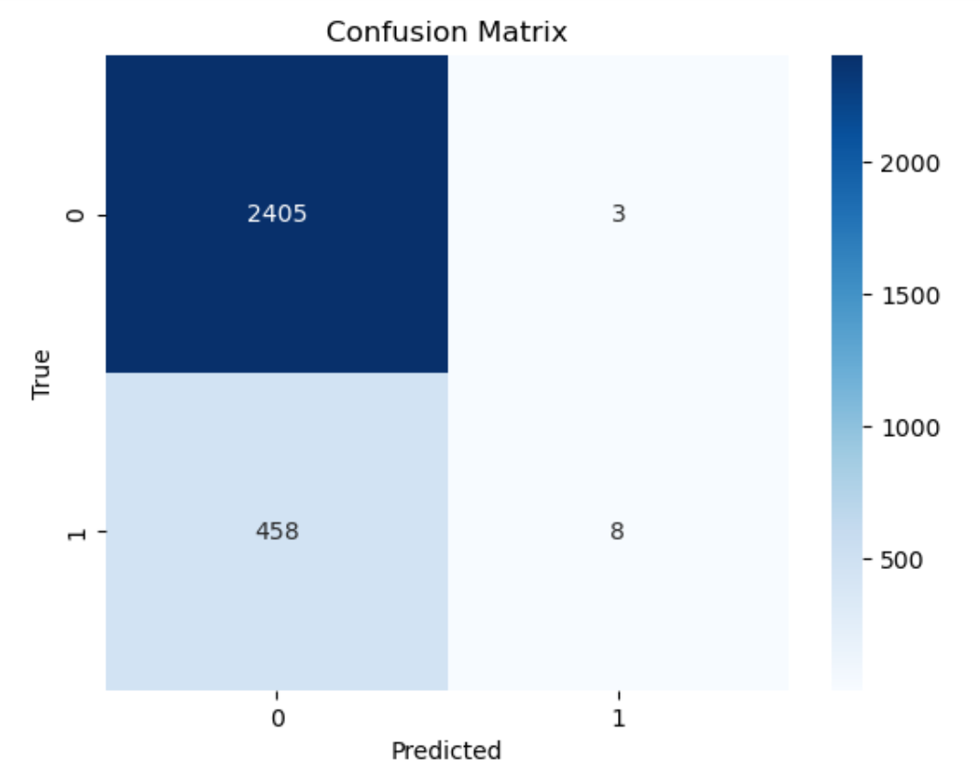
Confusion Matrix

Slide 8
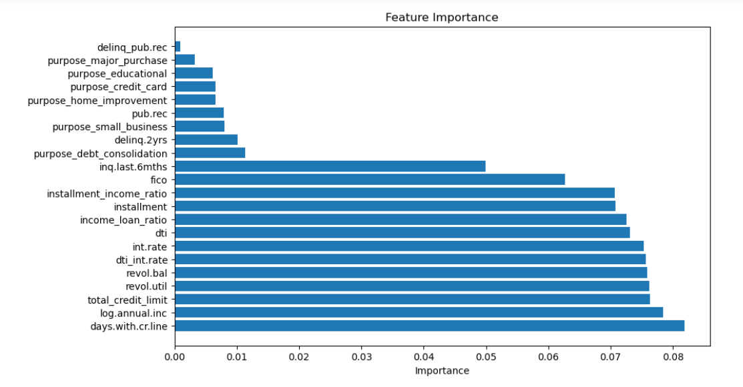
Feature Importance

Slide 9
Conclusion
Summary of Findings
Implications for Lending Club
Future Work: Further model improvements, additional features

Slide 10
Q&A
Floor is open for questions

